Slide 1
Technical Excellence 2020
The People Votes
Private and Confidential – Do not forward.

Slide 2
Submission Window August 1st ~ September 11th
People Vote September 16^{th ~} 26th
41 submissions
25 shortlisted
1 Workplace post
55 shares
1000+ total views
1609 people voted
2701 votes placed

Slide 3
The results
 | Solution | Number of votes
1 | BMW Group High Performance Data-Driven Development Platform for Autonomous Driving | 344
2 | Energy portal | 328
3 | Zurich UK Service Automation | 182
4 | Application Modernization and Automation solution for PDM Portal application in Zurich NA | 177
5 | Operational and technical support on CaixaBank's Watson Strategy | 168
6 | Mainframe Modernization & DevSecOps for Insurance | 164
7 | DXC Smart Wagon | 137
8 | Slovak eID - Electronic Identity Scheme Solutions | 120
9 | Low Emission Zone (LEZ) Brussels | 114
10 | DXC Digital Explorer | 105
11 | Modernizing AA’s Irregular Operations Application Suite | 96
12 | Automatic Backup Monitoring Solution | 89
13 | Real World Evidence for better Research and Clinical decisions | 77
14 | Ten-X CI/CD pipeline and automated Kubernetes solution | 70
15 | Re-engineering to Microservices & Containerization with Kubernetes and DevSecOps on Zurich VM | 65
16 | Smart metering Access Point Manager and Meter Data Management Solution | 63
17 | Integrating the Sipar2 application for the Flemish Government | 59
18 | Monitoring 360 | 56
19 | Smart Factory Service | 53
20 | DrillAR - Augmented Reality to monitor Mining Equipment | 51
21 | HP SPROUT CONFERENCE ROOM APPLICATION AND BADGE PRINTING APPLICATION | 45
22 | Xuber Insurance Digital Health Platform implementation | 44
23 | Fully Interactive User Interface Simulation of the Future - Made for Augmented and Virtual Reality | 41
24 | Multi Cloud High Availability Strategy | 39
25 | TELEOP logistics | 14

Slide 4
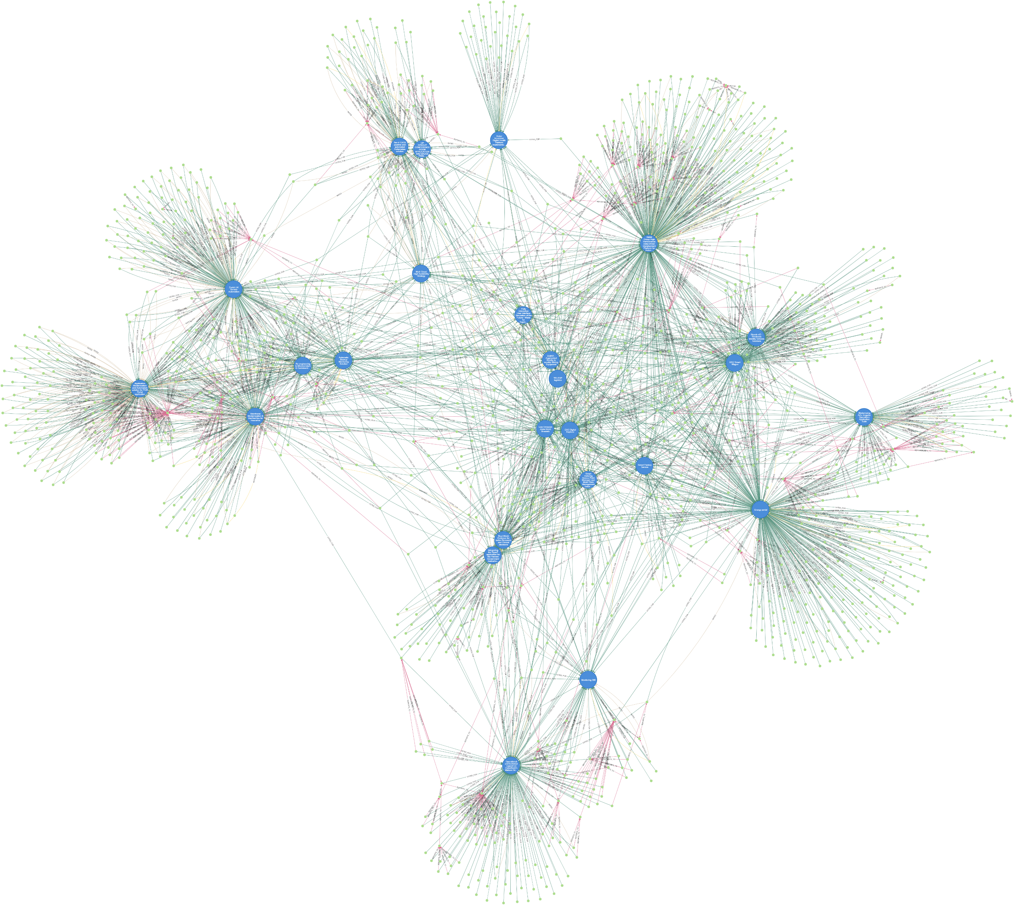
Voting Communities
Clear patterns of teams lobbying/promoting their nominations
High number of users voting for a single solution
Reporting Line
Voted for
Solution
Person

Slide 5
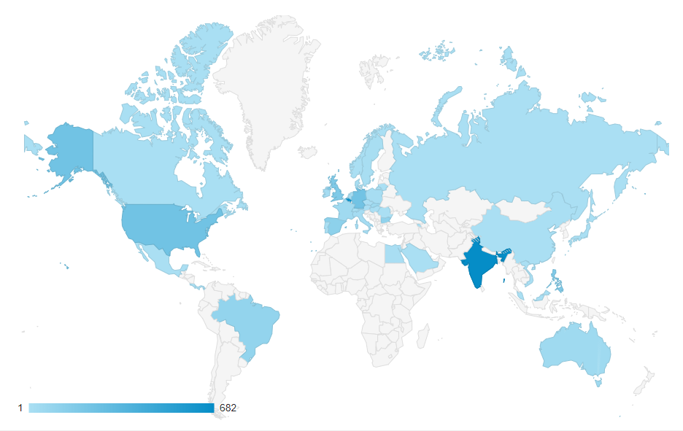
Detailed Usage Numbers
Users and Page Views
 | Mon | Tue | Wed | Thurs | Fri | Mon | Tue | Wed | Thurs
Users | 1003 | 605 | 554 | 316 | 206 | 160 | 134 | 68 | 42
Page Views | 2663 | 1510 | 1302 | 803 | 487 | 342 | 396 | 215 | 87
Top countries
 | Users
India | 682
Belgium | 666
US | 238
Germany | 233
UK | 177
 | Users
Philippines | 174
Spain | 120
Bulgaria | 110
Brazil | 96
Australia | 45

Slide 6
Observations
Communication policy has a negative effect on awareness (41 submissions) = zero awareness
Award team size needs to be reviewed – Digital project = scrum teams = 7-8 people. ANZ region voiced strong concerns this will exclude 3 technical members by default
rCTO engagement poor in some regions
DTC engagement poor in UKIIMEA region
Asia region impacted due to no rCTO
People Votes – Single post via Workplace
Sharing across Workplace was good (55 shares, 1000+ views)
Nominated teams got behind their solution and lobbied their peers
Industry groups supported their solutions
Excellent overall engagement within the South Europe region
Program members need permission to “pin” post to key workplace groups (CTO, AO)
No reported issues with the DE platform – highest volume of users to every access the platform, but still very low given overall employee numbers

Slide 7
Digital Explorer Enhancements from user community
Required before TE2021
Allow contacts to be identified as “award candidates”; thus removing the risk of too many contacts and a clear action for the team to select the number of people entitled to the award
General improvements (already in the backlog)
Simplify submission form (move save & cancel button into breadcrumbs)
Improve error reporting (form validation errors highlighted)
Allow editors to preview media and links
Datasheet : Merge contact with multiple roles into one line

